Slide 1
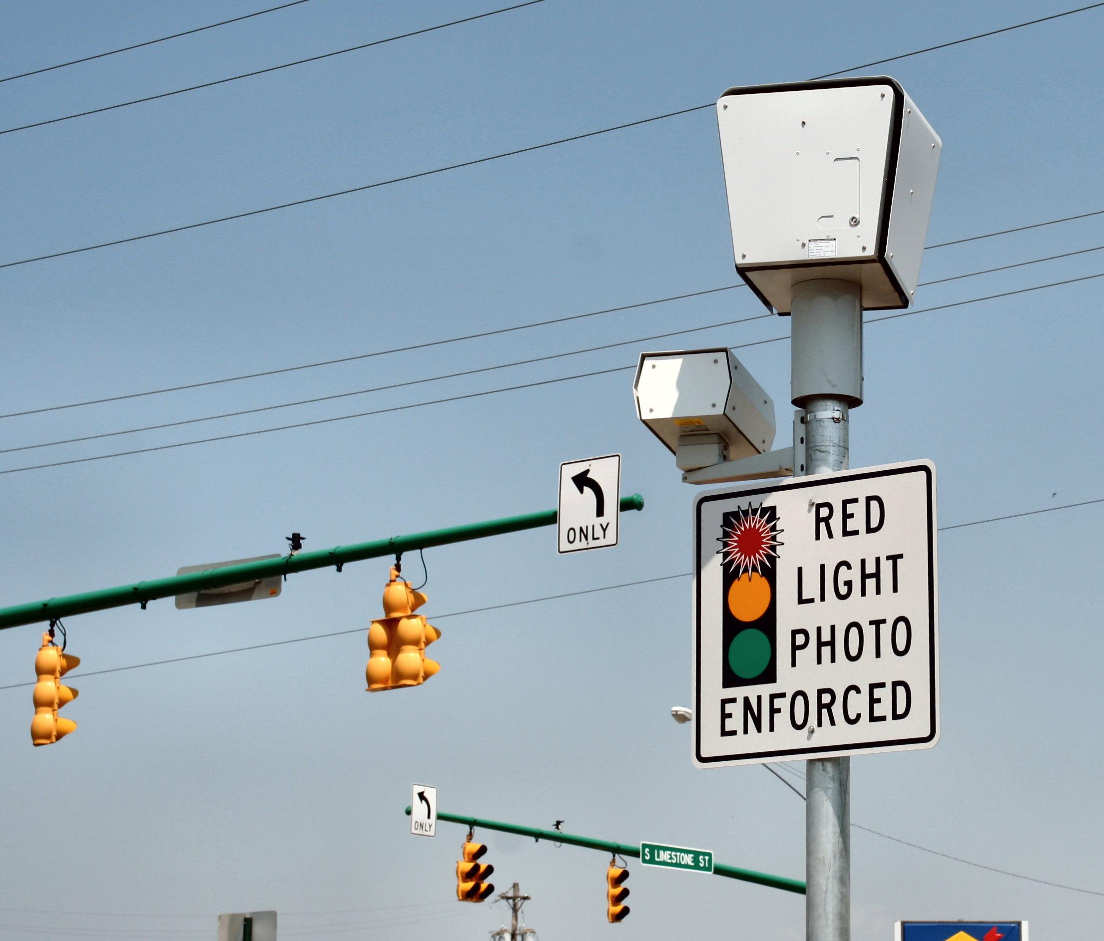
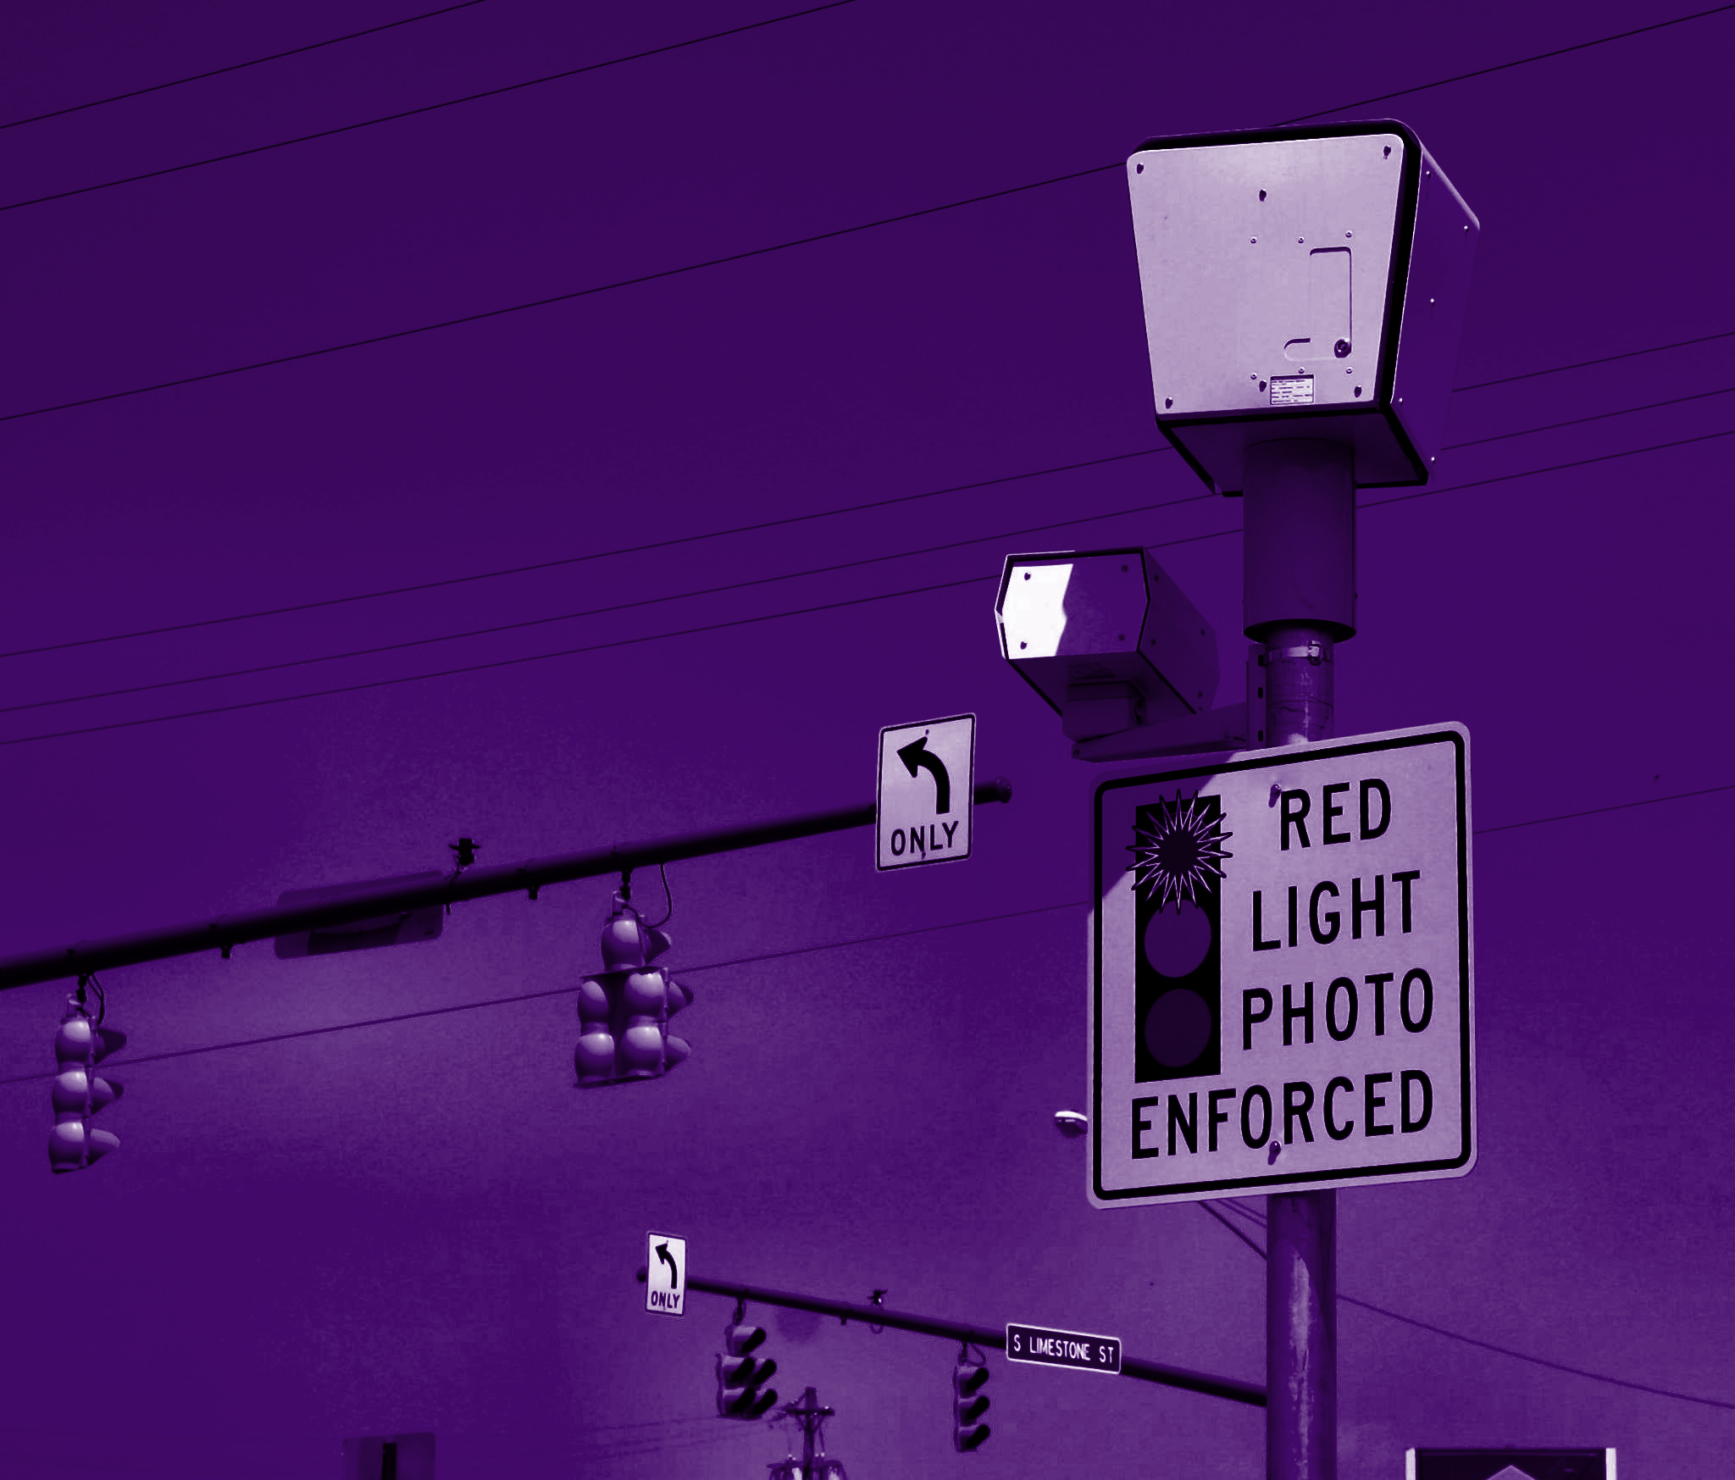

Automated Law Enforcement and Its Relationship with Traffic Violation in NYC
Presented by
Andrew Lan, Chih Yun Lu, Seung Hwa Lee, Soobin Lim, Jikun Liu, Tarea Karunaratne, Sam Zierler
04.29.2022
Applied Data Science
Prof. Stanislav Sobolevsky

Slide 3
Abstract
Introduction
Data
Analysis
Further considerations
Content

Slide 4



Problem Statement
the Amount of Automated Law Enforcement
the Frequency of the Corresponding Traffic Violation Incidents

Slide 5


Introduction
Automated Law Enforcement
Collecting
Comparing
Getting result
Traffic Violation

Slide 6
Data
NYPD B Summons (Historic)
Data Provided by New York Police Department (NYPD)
Dataset Owner NYC OpenData
Violation Code
Data Provided by New York City Department of Motor Vehicles
NYPD B Summons (Year to Date)
Data Provided by New York Police Department (NYPD)
Dataset Owner NYC OpenData
Open parking violation Data Speed/Red Light
Data Provided by New York City Department of Motor Vehicles

Slide 7
Data Issues
Inconsistent Labelling: Data labelling for borough names
Incomplete Data:Datasets were often more complete for some areas than others
Lack of Data Availability: Relatively new project

Slide 8
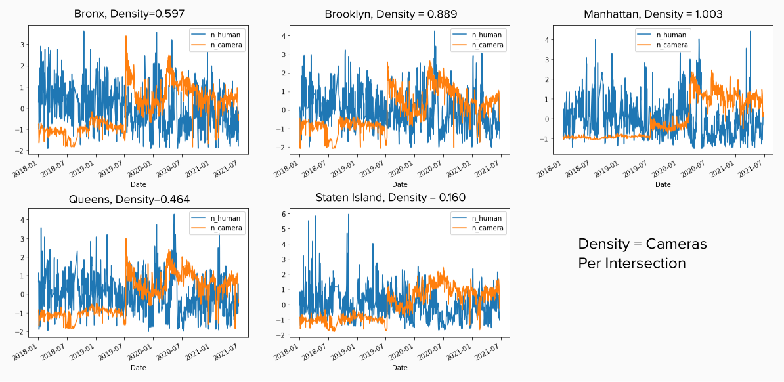
Analysis- Trend/
Density
Camera density per intersection by borough

Slide 9
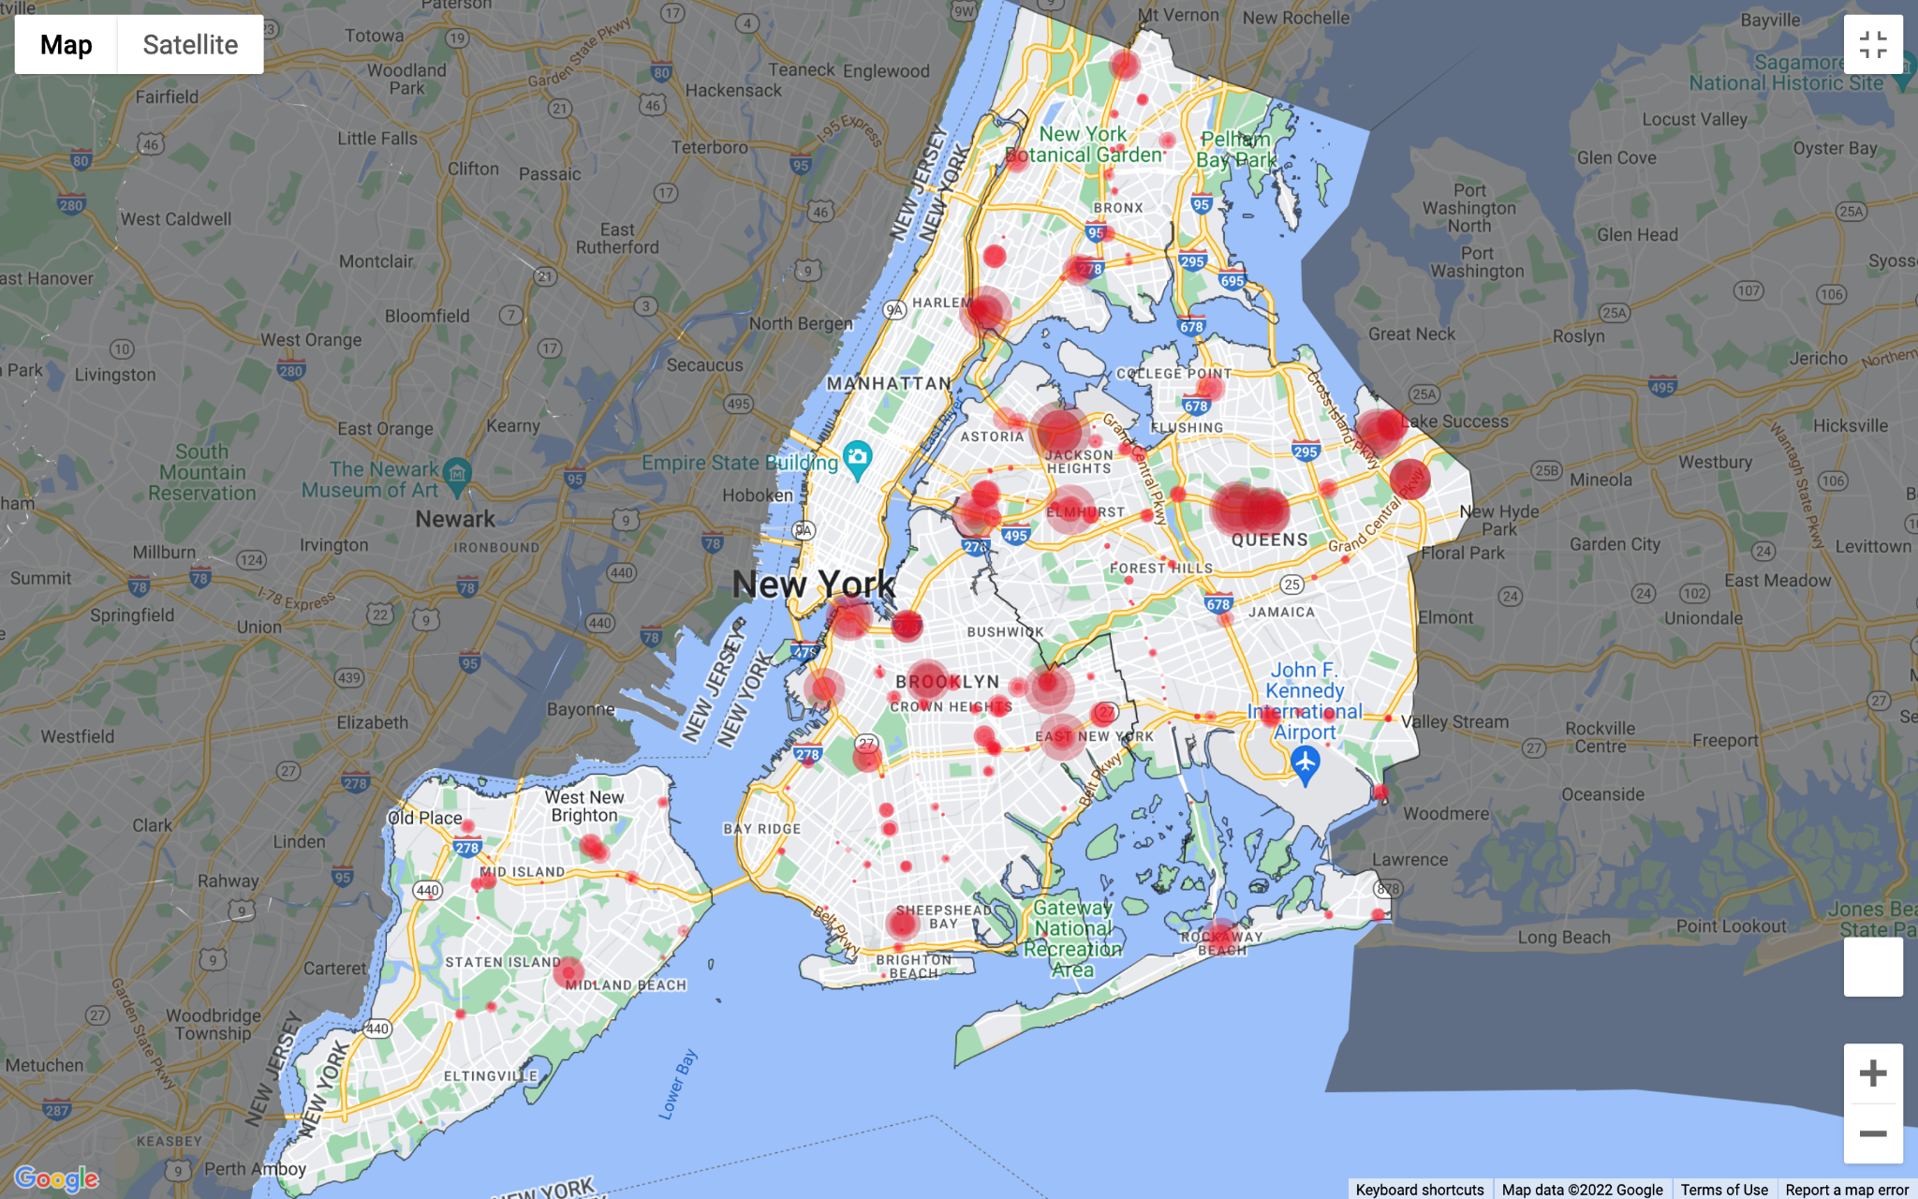
Analysis-
Volume
2019 Red Light Cameras

Slide 10
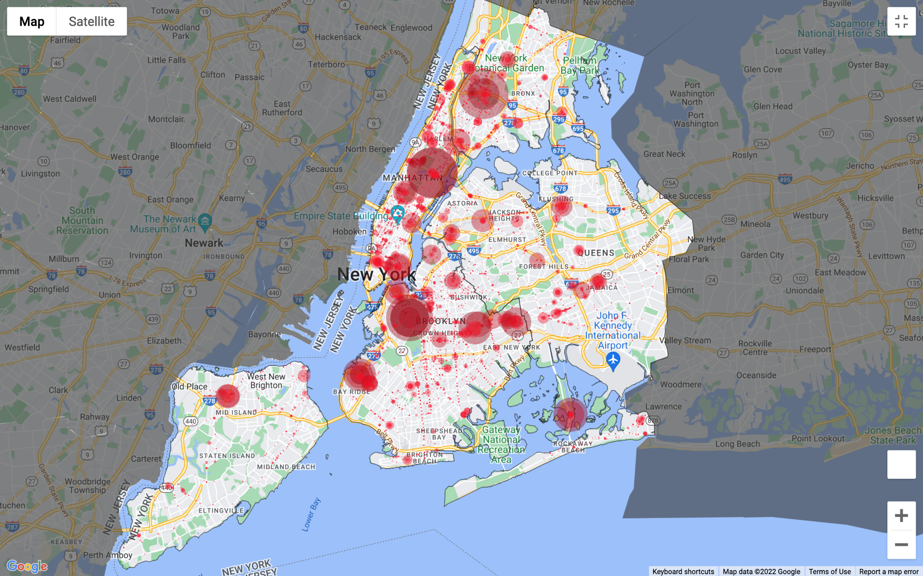
2019 Red Light summons

Slide 11
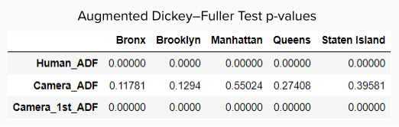
Analysis-
ADF Test & ARIMA

Slide 12
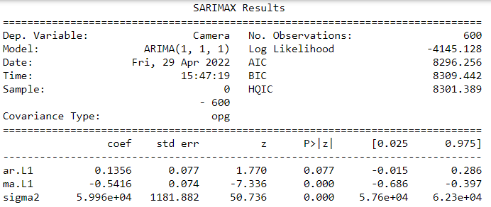

Slide 13
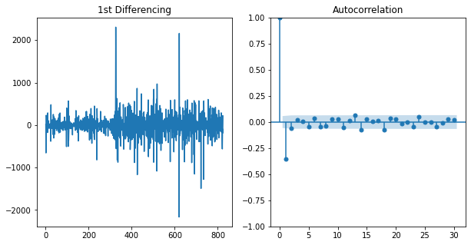
Autocorrelation

Slide 14
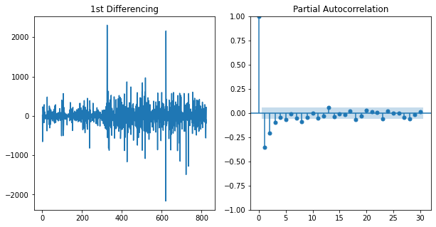
Partial Autocorrelation

Slide 15
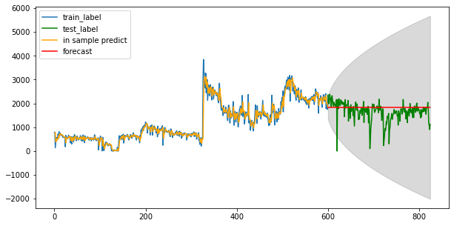
Prediction

Slide 16
Conclusion
The overall law enforcement for traffic violations through NYC = consistent
The overall traffic violations caught by cameras
The efficiency of automated law enforcement in Manhattan

